Slide 1
Introduction to Vehicle Architecture
Notes:
Vehicle architecture encompasses the fundamental design and structural layout of a vehicle, integrating various mechanical and electronic systems to create a cohesive and functional whole.

Slide 2

Agenda
01
Sub Systems
02
Engine
03
Power Delivery
04
Control and Feedback
05
Instrumentation and Driver Interface

Slide 3
Agenda
06
Electrical System
07
Emissions & Comfort
08
Body and Visibility
09
Advanced
Vehicle Systems
10

Slide 4

01– Sub Systems

Slide 5
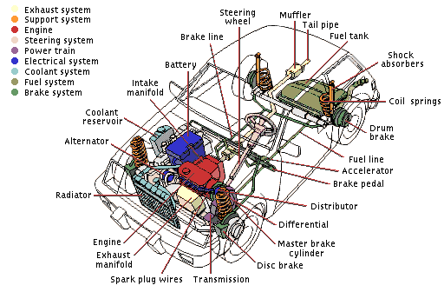

Slide 6
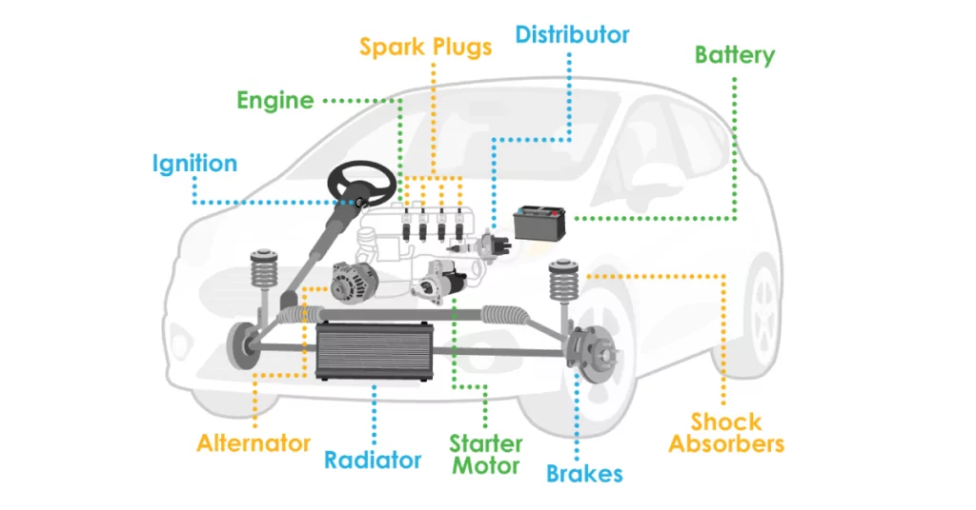

Slide 7
02 – Engine

Slide 8
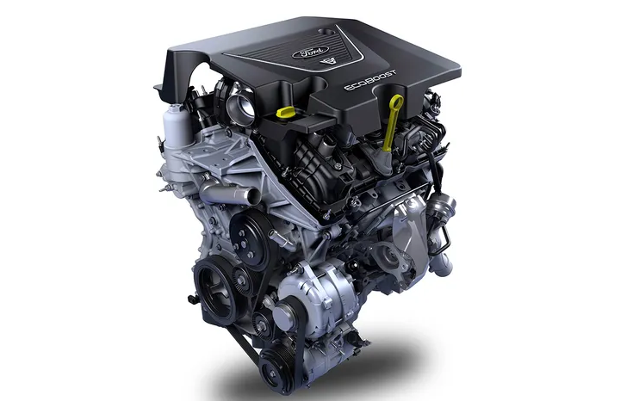
Engine
Engine
Overview
Definition: Core vehicle component converting gasoline heat to motion.
Purpose: Drives vehicle mobility and efficiency.
Working Principle:
Spark-ignited combustion of gasoline-air mixture.
Key Components:
Cylinders
Spark Plugs
Protection Measures:
Cooling Systems
Oil Lubrication
Notes:
Definition: The engine is the car's powerhouse, complexly engineered to turn gasoline into motion.
Purpose: It operates on the principle of internal combustion, where a spark triggers a reaction by igniting a precise mixture of air and gasoline vapor within a sealed cylinder.
Working Principle: The rapid burning of air and gasoline mixture produces energy that moves the car's wheels.
Key components facilitating this process include cylinders where combustion occurs and spark plugs that provide the essential spark.
Protection Measures: Protection for the engine is provided through cooling systems that manage heat and oil lubrication that minimizes wear.
Regulatory Compliance: Adherence to emission and efficiency standards is critical to meet regulatory compliance, ensuring the engine's operation is environmentally conscious and fuel-efficient.

Slide 9
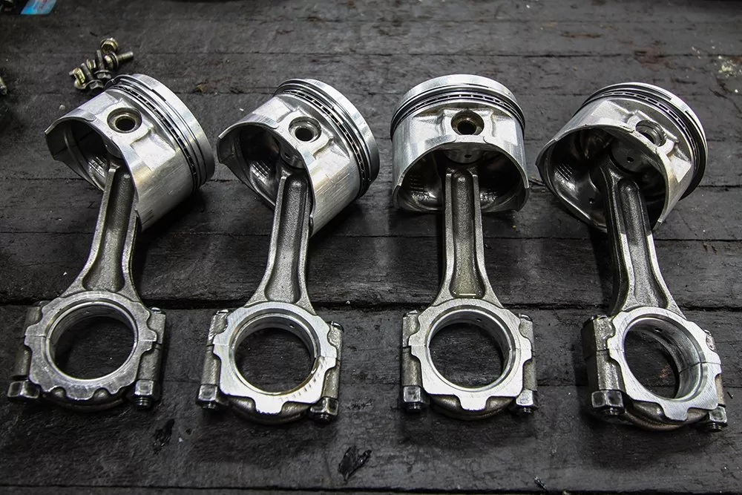
Pistons
Overview
Pistons
Definition: Cylindrical components that move within the engine's cylinders.
Importance: Fundamental for converting fuel combustion into mechanical motion.
Motion Conversion: Translate combustion energy to crankshaft movement.
Power Generation: Affect engine's power output and speed.
Notes:
Pistons are crucial for an engine's operation, acting directly within the combustion chamber.
Their reciprocating motion, driven by fuel combustion, is transformed into rotational motion by the crankshaft, propelling the vehicle.
The number of pistons within an engine can vary, influencing the engine's power and smoothness.

Slide 10
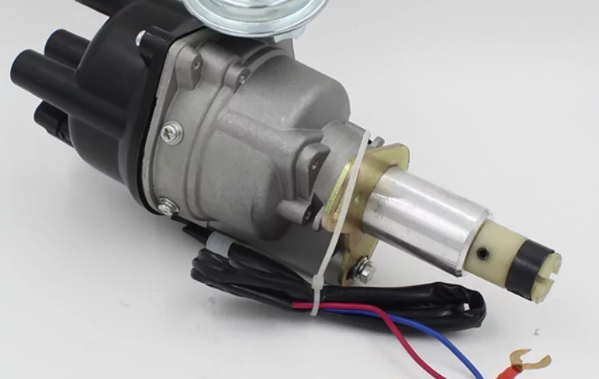
Ignition System/ Spark Plugs
Overview
Spark Plugs
Definition: Components that initiate combustion in an engine's cylinders.
Importance: Essential for starting the engine and supporting efficient combustion.
Spark Generation
Timing Accuracy
Engine Performance
Notes:
Definition: The ignition system, with spark plugs as key components, creates a high-voltage electrical spark to ignite the mixture of air and fuel in the combustion chamber, essential for powering the engine.
Importance: Proper functioning of the ignition system is crucial for engine start-up, performance, and fuel efficiency. Spark plugs must fire accurately thousands of times per minute, and any failure or inefficiency can lead to engine problems like misfiring, rough running, or decreased power.
Spark Generation: Spark plugs must generate a strong and precise spark to ignite the air-fuel mixture, which varies with engine speed and load.
Timing Accuracy: The ignition system's timing is meticulously controlled to ensure that sparking occurs at the most effective moment based on the engine's operational state.
Engine Performance: A well-maintained ignition system, with clean, correctly gapped spark plugs, contributes to optimal engine performance, lower emissions, and better fuel economy.

Slide 11

Fuel Tank System
Overview
Fuel Tank
Definition: A container that stores fuel for the vehicle's engine.
Importance: Provides a safe and durable reservoir for fuel supply.
Location: Positioned ahead of the rear axle for safety.
Material: Constructed to withstand impact and prevent leaks.
Notes:
Definition: The fuel tank is a critical component designed to hold the gasoline or diesel that powers the car's engine. Its integrity is vital for the vehicle's operation.
Importance: Proper placement and construction are crucial for safety, preventing fuel spillage in the event of a collision and ensuring a steady supply of fuel to the engine.
Location: The strategic location of the fuel tank is to minimize the risk of damage and subsequent fuel leakage during an accident.
Material: Typically made from high-strength materials to endure the stresses of daily operation and to resist corrosion and punctures.

Slide 12
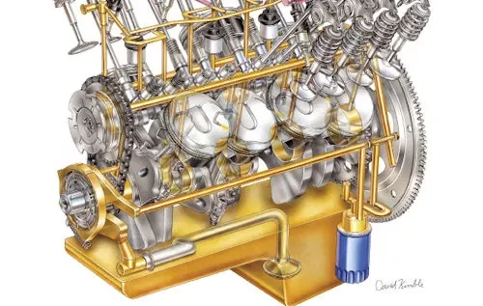
Lubrication System
Overview
Lubrication System
Definition: A system that distributes oil to reduce friction between moving engine parts.
Importance: Essential for reducing wear, cooling engine components, and improving efficiency.
Friction Reduction
Engine Cooling
Sealant Properties
Notes:
Definition: The lubrication system plays a pivotal role in an engine's longevity and performance by ensuring that all moving parts are sufficiently lubricated to minimize friction and wear.
Importance: Beyond reducing wear, the lubrication system contributes to engine cooling by absorbing heat from moving parts and acting as a sealant to enhance engine efficiency.
Friction Reduction: By circulating oil, the system creates a thin barrier between moving parts, which significantly reduces friction and the potential for metal-on-metal contact.
Engine Cooling: While the primary purpose is lubrication, the oil also carries away heat from critical areas, aiding in temperature regulation.
Sealant Properties: The lubricant helps seal gaps between the piston rings and cylinder walls, improving compression and preventing the escape of combustion gases.

Slide 13
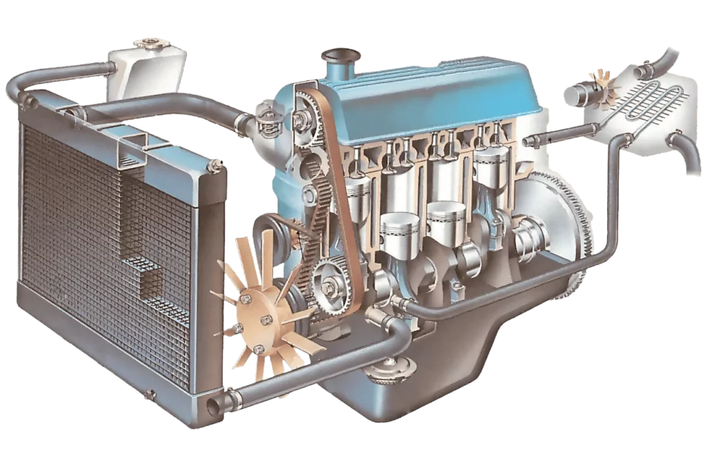
Cooling System
Overview
Cooling System
Definition: A system designed to maintain optimal engine temperature.
Importance: Prevents overheating and ensures consistent performance and durability.
Temperature Regulation
Component Protection
Efficiency Improvement
Notes:
Definition: The cooling system manages the engine's temperature by dissipating heat generated during combustion, ensuring the engine operates within a safe temperature range.
Importance: Proper functioning of the cooling system is critical to avoid overheating, which can lead to engine failure, and to ensure the engine runs efficiently under various operating conditions.
Temperature Regulation: Utilizes coolant fluid to absorb and transfer heat away from the engine to a radiator where it is cooled by air.
Component Protection: By maintaining the engine at the right temperature, the system prevents thermal stress and warping of engine components.
Efficiency Improvement: A well-regulated engine temperature contributes to more complete fuel combustion, reducing emissions and improving fuel efficiency.

Slide 14
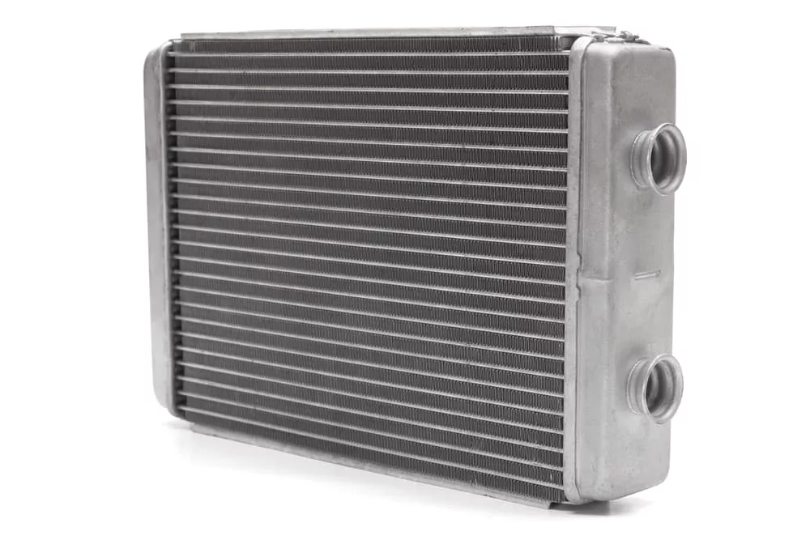
Radiator
Radiator
Radiator and Cooling System
Definition: A component that dissipates heat from the engine.
Importance: Prevents engine overheating and maintains optimal performance.
Coolant Circulation
Heat Dispersion
System Components
Maintenance Tip
Notes:
Definition: The radiator is a vital part of the vehicle's cooling system that keeps the engine at the right temperature by removing excess heat.
Importance: By preventing the engine from overheating, the radiator contributes to the engine's performance and longevity.
Coolant Circulation: The cooling system circulates a liquid coolant, which absorbs heat from the engine and is then cooled down as it passes through the radiator.
Heat Dispersion: The design of the radiator's core, with its large surface area, allows for the efficient release of heat into the air, aided by a fan when needed.
System Components: Other components of the cooling system include hoses that transport the coolant, a fan to draw air through the radiator, and a thermostat that monitors the temperature of the coolant.
Maintenance Tip: Regularly checking the coolant level and the condition of the radiator and its components can prevent breakdowns and ensure the longevity of the engine. It's advised to check the coolant level at least twice a year.

Slide 15
03 – Power Delivery

Slide 16
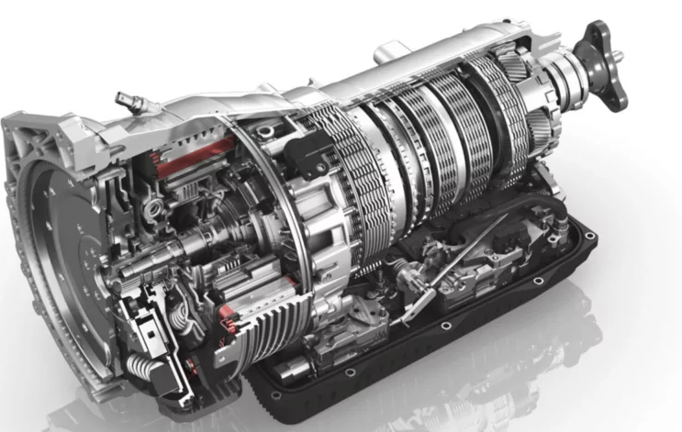
Transmission
Transmission
Overview
Definition: A system that regulates engine torque to the wheels.
Purpose: Adjusts vehicle speed and power efficiency.
Gear Ratio Adjustment
Gearbox Mechanism
Engine Mounting
Performance Tuning
RPM Maintenance
Notes:
Definition: The transmission is a key component in the powertrain that manages the torque transferred from the engine to the wheels, crucial for driving dynamics.
Purpose: Its primary function is to ensure the vehicle can adjust its speed and maintain power efficiency across different driving scenarios.
Gear Ratio Adjustment: By changing the gear ratio, the transmission controls how much torque is transferred to the wheels, affecting acceleration and fuel efficiency.
Gearbox Mechanism: The transmission operates like a bicycle's gear system, using a series of gears and belts to adjust the vehicle's drive based on engine power.
Engine Mounting: Typically mounted directly to the engine to efficiently convert combustion power into motion.
Performance Tuning: Automatically shifts gears relative to the vehicle's speed and the degree of throttle applied, ensuring smooth transitions and optimal power.
RPM Maintenance: Balances the engine's revolutions per minute to avoid over-revving, maintaining performance and preventing engine strain.

Slide 17
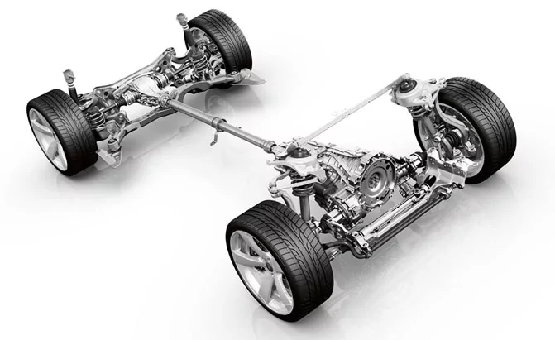
Power Train
Power Train
Overview
Definition: A system that transfers engine power to the vehicle's wheels.
Purpose: Facilitates vehicle movement and enhances driving efficiency.
Clutch (in manual transmissions)
Transmission
Drive Shaft
Differential
Rear Axle
Notes:
Definition: The powertrain encompasses all the components that drive the car forward by transferring power from the engine to the wheels. It's fundamental to the vehicle's ability to move.
Purpose: The system's main purpose is to efficiently translate the engine's power into motion, allowing for smooth acceleration, driving, and handling under various conditions.
Clutch (in manual transmissions): Connects and disconnects the engine from the transmission to allow gear changes.
Transmission: Modulates the engine’s power, adapting it to the car’s speed and load through different gear ratios.
Drive Shaft: Transfers the modified power from the transmission to the differential.
Differential: Distributes the power to the wheels, allowing them to rotate at different speeds (important for turning).
Rear Axle: Holds the wheels together and transfers power from the differential to the wheels.

Slide 18
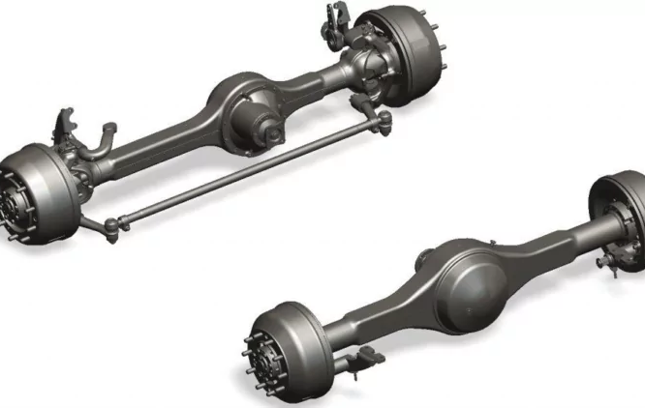
Axles
Axles
Overview
Definition: Shafts that support and drive the vehicle’s wheels.
Importance: Critical for steering, power transmission, and shock absorption.
Front Axle: Integral to steering and suspension.
Rear Axle: Connects with the differential for power distribution.
Notes:
Definition: Axles are essential mechanical elements that support the weight of the vehicle and transfer driving force to the wheels.
Importance: They are pivotal in vehicle dynamics, contributing to handling, ride quality, and the drivetrain's effectiveness.
Front Axle: Comprises the beam, swivel pin, track rod, and stub axle, providing structural support, facilitating steering, and absorbing road shocks.
Rear Axle: This is situated between the differential and the moving wheels, transferring power and accommodating vehicle load. It is composed of two half shafts connected by the differential, which allows for differential wheel speed during turns.
Most vehicles feature axles that are designed to optimize power delivery and ensure stability during various driving maneuvers. Regular maintenance of axle components is necessary to preserve the vehicle's safety and operational integrity.

Slide 19

Clutch
Overview
Clutch
Definition: A mechanical device that engages and disengages the engine from the transmission.
Importance: Facilitates smooth gear shifts and power transmission control.
Driver Control
Power Transmission
Smooth Gear Shifts
Notes:
Definition: The clutch is an integral part of the drivetrain, providing a disconnect between the engine and the transmission system. It allows the driver to control the transfer of power from the engine to the wheels, making it possible to start, stop, and change gears smoothly.
Importance: The clutch's role is critical in manual transmission vehicles for ensuring a smooth transition of power and preventing stalling during gear changes. It helps in managing vehicle speed and acceleration efficiently.
Driver Control: Through the clutch pedal, drivers can temporarily disconnect the engine's power to the drivetrain, allowing for gear changes or stopping the vehicle without turning off the engine.
Power Transmission: When engaged, the clutch transmits engine power to the transmission, and when disengaged, it cuts the power flow, allowing for gear changes.
Smooth Gear Shifts: The clutch must be operated smoothly to prevent wear on the transmission gears and to ensure the longevity of the clutch itself.

Slide 20
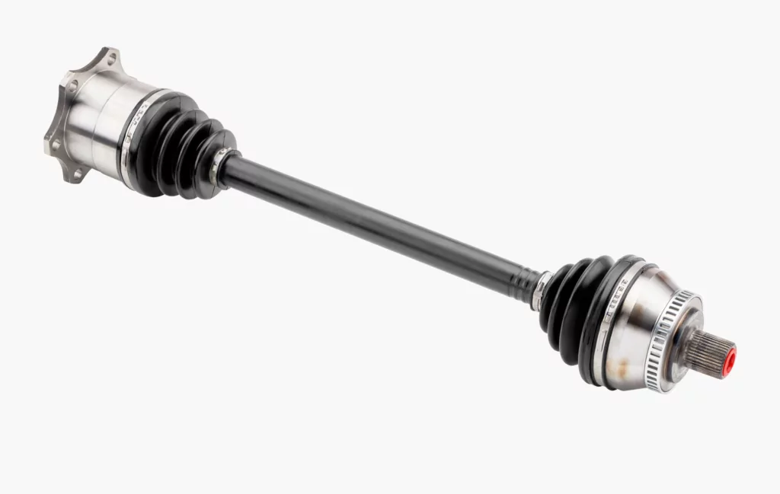
Drive Shaft
Overview
Drive Shaft
Definition: Connects the gearbox to the differential unit in a vehicle.
Importance: Transmits power from the engine to the wheels.
Universal Joint: Allows for flexibility in angle and rotation.
Notes:
The drive shaft, crucial for transmitting mechanical power from the gearbox to the differential, features a universal joint at each end to accommodate the movement and angle changes of the vehicle's components during operation.

Slide 21

Differential
Definition: Distributes engine power to the wheels, allowing for different speeds.
Importance: Essential for smooth turning and handling.
Variable Wheel Speed: Enables the wheels to rotate at different speeds during turns.
Notes:
The differential plays a pivotal role in vehicle maneuverability, especially when turning or navigating uneven surfaces, by adjusting the speed of each rear wheel to match the turning radius, thus preventing tire slippage and improving handling.

Slide 22
04 – Control and Feedback

Slide 23
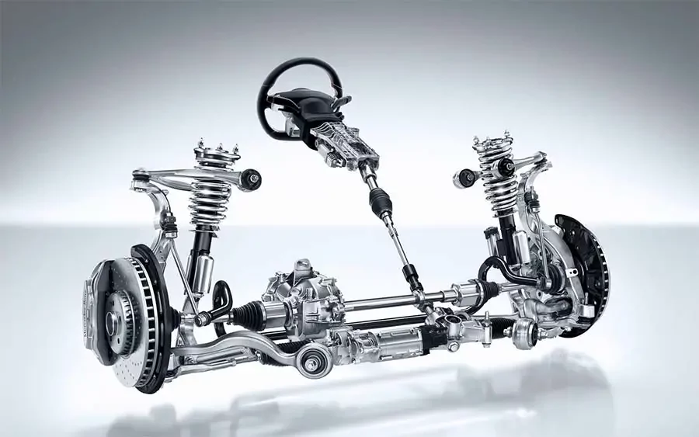
Steering System
Overview
Steering System
Definition: A mechanism that enables directional control of a vehicle.
Importance: Critical for maneuverability and safe navigation.
Directional Control: Allows the vehicle to be steered as intended.
Steering Gear: Amplifies the driver's steering input for ease of use.
Notes:
Definition: The steering system comprises various components that work together to allow the driver to guide the vehicle in the desired direction with precision and minimal effort.
Importance: Accurate steering is not only essential for everyday driving but also for safety, especially when navigating through traffic or reacting to road conditions.
Directional Control: It's crucial for the steering system to be responsive and reliable, ensuring that the vehicle responds accurately to the driver's commands.
Steering Gear: This gear mechanism increases the force applied by the driver, making it easier to turn the wheels even when the vehicle is stationary or moving slowly.
Returnability: After a turn, the steering system is designed so that the front wheels naturally return to the straight-ahead position, aiding in driving stability and reducing driver workload.

Slide 24
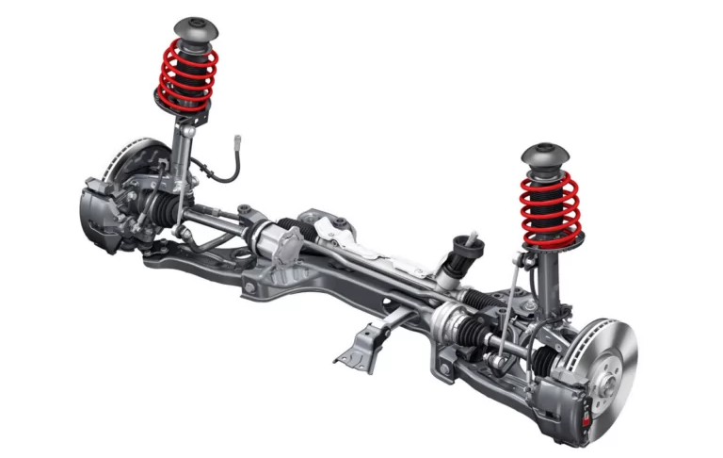
Suspension
Suspension
Overview
Definition: A network of components that supports vehicle stability and handling.
Importance: Maintains tire contact and absorbs road irregularities.
Connective Components
Movement Synchronization
Shock Absorption
Design Variability
Notes:
Definition: The suspension system includes various parts under the wheel housing that work together to support the car’s weight and to help the tires maintain contact with the road.
Importance: It’s crucial for vehicle safety, comfort, and the integrity of both the vehicle and cargo during travel.
Connective Components: Elements such as ball joints, tie rods, and bushings link the vehicle's chassis to the wheels, providing pivotal movement and support.
Movement Synchronization: These components ensure that the wheels and the vehicle body move in harmony, especially when navigating uneven surfaces or making turns.
Shock Absorption: The suspension system helps to absorb the shocks from road bumps and potholes, contributing to a smoother ride and less wear on the vehicle.
Design Variability: There are various suspension system designs, including independent, semi-independent, and solid axle configurations, each with specific advantages for different driving conditions and vehicle types. Regular maintenance and inspection of the suspension system are vital for optimal vehicle performance and longevity.

Slide 25
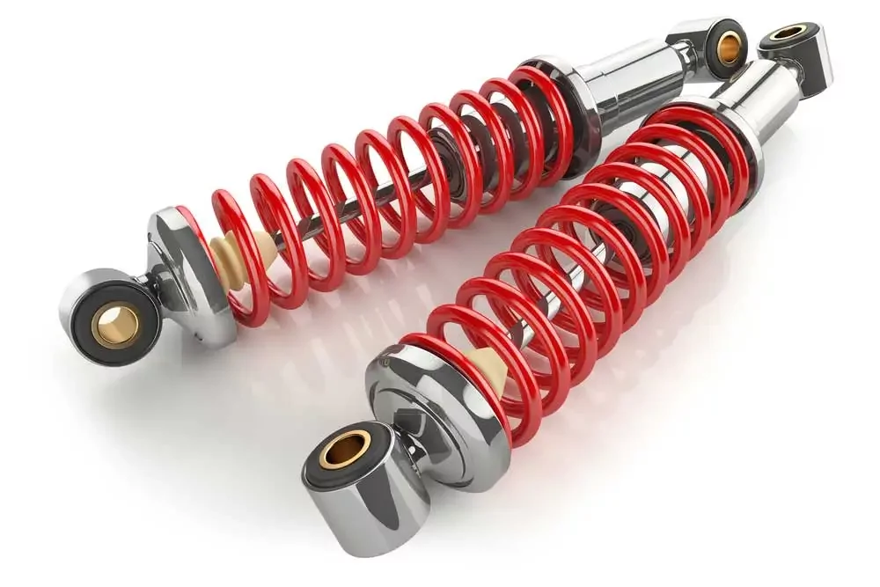
Shock Absorbers
Overview
Shock Aborbers
Definition: Components that dampen and stabilize a vehicle's movement.
Importance: Essential for maintaining tire contact with the road and ride comfort.
Stability Enhancement
Ride Comfort
Notes:
Definition: Shock absorbers are part of the suspension system, playing a crucial role in absorbing and dampening the shock from road surfaces, thus ensuring a smoother ride.
Importance: They contribute significantly to the safety and comfort of the vehicle by maintaining constant contact between the tires and the road, providing stability, and improving the effectiveness of the brakes.
Stability Enhancement: By absorbing the energy from road bumps and dips, they prevent excessive bouncing and movement of the vehicle, aiding in better control and handling.
Ride Comfort: They mitigate the feel of rough terrain, reducing the wear on the suspension system and the vehicle as a whole.
Wear and Tear: Over time, shock absorbers can wear out, leading to a bouncier ride, reduced handling precision, and increased tire wear. Symptoms of worn-out shocks include vibrations during driving and uneven tire wear.

Slide 26
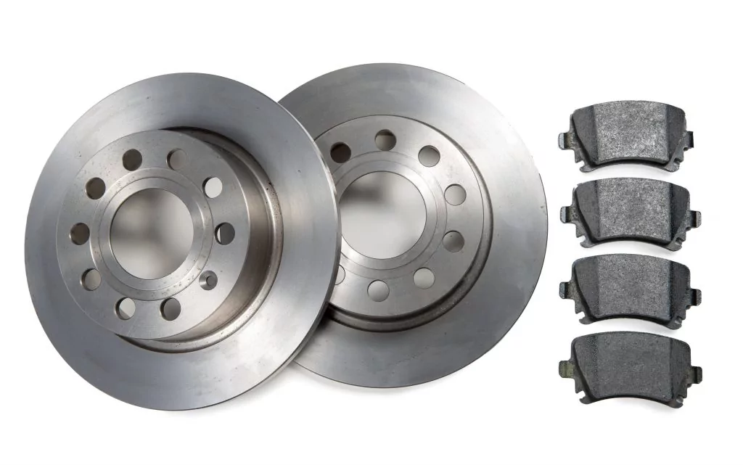
Braking System
Brakes
Overview
Definition: Mechanisms for slowing down or stopping a vehicle.
Importance: Essential for vehicle control and safety.
Disc Brakes
Drum Brakes
Wear Over Time
Notes:
Definition: The braking system is a critical safety feature in vehicles, allowing drivers to reduce speed or come to a complete stop.
Importance: Beyond controlling speed, brakes are also necessary to safely immobilize a vehicle when parked.
Disc Brakes: In this system, calipers squeeze the brake pads against the rotors to create friction and slow the vehicle down.
Drum Brakes: Brake shoes press outwards against a spinning drum situated inside the wheel, generating friction.
Wear Over Time: It's normal for brake components to wear down; noticing any change in how brakes feel or sound should prompt an inspection to ensure safety.
The effective functioning of the braking system is critical for safe driving, and regular maintenance is crucial for the system's reliability and the vehicle's longevity.

Slide 27
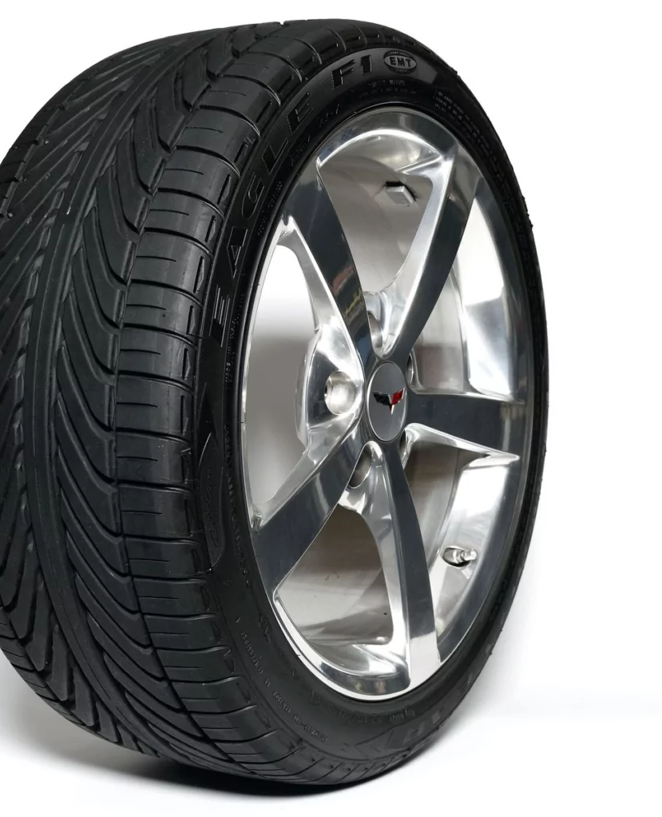
Wheel/Tire
Definition: Rubber components that make contact with the road.
Importance: Ensures traction, supports vehicle load, and aids in handling.
Material: Crafted from durable rubber.
Inflation: Filled with nitrogen or air for cushioning and performance.
Quantity: Standard set of four per vehicle.
Notes:
Definition: Tires are the part of the vehicle that make direct contact with the road, crafted from rubber for flexibility and strength.
Importance: They play a critical role in safety and performance, providing the necessary grip for acceleration, braking, and maneuverability.
Material: The choice of rubber as a material for tires is due to its durability and ability to conform to the road surface for maximum traction.
Inflation: Tires can be filled with air or nitrogen, the latter being less prone to temperature-related pressure changes, which can improve handling and fuel efficiency.
Quantity: A standard vehicle is equipped with four tires, one at each corner, to support the vehicle's structure and distribute its weight evenly for a stable ride.
Regular maintenance including pressure checks and rotation is key to extending tire life and ensuring optimal vehicle performance.

Slide 28
05 – Instrumentation & Driver Interface

Slide 29

Gear Shift
Definition: A lever that enables the driver to change gears in a vehicle.
Importance: Critical for controlling vehicle speed and direction.
Driver Control: Enables selection of forward, reverse, or neutral.
Manual and Automatic: Known as "stick shift" in manual and "gear selector" in automatic transmissions.
Gear Selection: Allows for a smooth transition between gears.
Notes:
Definition: The gear shift is a fundamental component of a vehicle's transmission system, allowing the driver to manually select the appropriate gear or setting for the driving conditions.
Importance: Its functionality is essential in both manual and automatic transmission vehicles for efficient power transmission from the engine to the wheels, facilitating acceleration, deceleration, and the ability to maintain a stationary position.
Driver Control: In manual transmissions, the gear shift works in conjunction with the clutch to engage or disengage different gears, requiring the driver to operate the clutch pedal simultaneously for smooth gear transitions.
Manual and Automatic: While manual transmissions require the driver to select each gear, automatic transmissions use a gear selector that automates gear choice based on the vehicle's speed and engine load, simplifying the driving process.
Gear Selection: Proper use and understanding of the gear shift or selector are crucial for driving efficiency, fuel economy, and preventing undue wear on the transmission.

Slide 30

Speedometer
Overview
Speedometer
Definition: A dashboard instrument that displays the vehicle's speed.
Importance: Provides drivers with essential information for safe driving.
Speed Measurement: Indicates how fast the vehicle is traveling.
Notes:
The speedometer is a key instrument for driver awareness, offering real-time data on vehicle speed to ensure adherence to speed limits and safe driving conditions.
It functions by receiving data from the vehicle's transmission, reflecting the speed in either kilometers per hour (km/h) or miles per hour (mph).

Slide 31

Fuel Guage
Overview
Fuel Guage
Definition: An instrument that indicates the vehicle's fuel level.
Importance: Essential for monitoring fuel availability and planning refills.
Fuel Level Monitoring
System Components
Notes:
The fuel gauge is a crucial component of a vehicle's dashboard, providing real-time information on the amount of fuel remaining, thereby helping to avoid unexpected stalls due to fuel depletion.

Slide 32

Temperature Guage
Overview
Temperature Guage
Definition: An instrument that indicates the temperature of the engine's coolant.
Importance: Essential for monitoring engine temperature to prevent overheating.
Engine Health Indicator: Alerts to low, normal, or high coolant temperatures.
Coolant System Check: Works in conjunction with a temperature sensor.
Notes:
The temperature gauge is a vital component on the vehicle's dashboard, providing a visual representation of the engine coolant's temperature. It alerts the driver to potential overheating, which could indicate a malfunction within the cooling system, allowing for timely intervention to prevent engine damage.
Understanding the normal operating range of your vehicle's engine temperature and monitoring any deviations is crucial for maintaining engine health and performance.

Slide 33

Car Trip Meter
Overview
Odometer & Car Trip Meter
Definition: A feature that measures the distance traveled by a vehicle since the last reset.
Importance: Useful for tracking trip distances and managing vehicle use.
Distance Tracking
Odometer vs. Trip Meter: The trip meter complements the odometer by offering more specific journey measurements.
Notes:
The car trip meter is a convenient tool found alongside the odometer on a vehicle's dashboard, designed to measure the length of specific trips. By allowing drivers to reset it at the start of a journey, the trip meter provides valuable data for navigation, fuel efficiency calculations, or monitoring the distance of regular routes such as commutes.

Slide 34

Rev Counter
Overview
Rev Counter
Definition: An instrument measuring the engine's rotational speed in RPM.
Importance: Provides insights into engine operation and performance.
Engine Speed Indicator
Performance Monitoring
Notes:
The rev counter, or tachometer, is a critical dashboard instrument that displays the engine's speed in revolutions per minute (RPM), offering the driver real-time data on engine performance.
Monitoring the RPM can aid in achieving better fuel efficiency by signaling the optimal points for gear changes in manual vehicles or understanding the engine's workload.
High RPMs can indicate high engine load, while low RPMs suggest more economical driving conditions. Proper use of the rev counter can enhance driving experience and vehicle maintenance by avoiding excessive strain on the engine.

Slide 35
06 – Electrical System

Slide 36

Battery
Overview
Battery
Definition: A reserve of chemical energy for car's electrical needs.
Importance: Powers the car's electrical components.
Battery Terminal
Cold-Start Amps
Group Size
AGM Technology
Notes:
Definition: The car battery is essential for storing chemical energy and converting it into electrical energy, which is crucial for starting and powering the vehicle's electrical systems.
Importance: The battery is not just for starting the car; it's also responsible for providing power to all electrical components when the engine isn't running and supporting the charging system while the engine is running.
Battery Terminal: These are the points at which the battery connects to the car's electrical system, facilitating the flow of electricity.
Cold-Start Amps: This term refers to the amount of current the battery can provide to start the car under cold temperature conditions.
Group Size: Indicates the physical size, power capacity, and the battery's placement configuration in the vehicle.
AGM Technology: AGM batteries use a fiberglass mat to absorb sulfuric acid, reducing the likelihood of leaks and maintaining a charge more effectively, especially in demanding conditions.

Slide 37
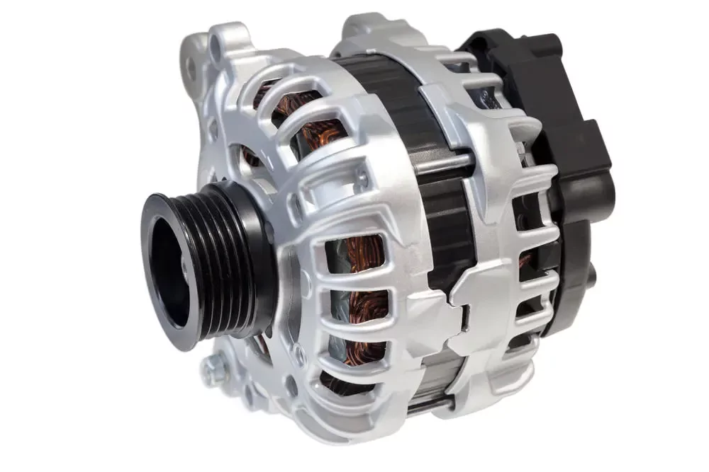
Alternator
Alternator
Overview
Definition: A device that converts mechanical energy to electrical energy for the car's use.
Importance: Essential for the car's electrical operation and battery recharging.
Partnership with Battery
AC Conversion
Battery Charging
Engine Connection
Notes:
Definition: The alternator is a crucial component that works with the battery to power the car's electronics and to keep the battery charged.
Importance: While the battery starts the car, the alternator takes over once the engine is running, supplying power and recharging the battery for future starts.
Partnership with Battery: The alternator and battery have a symbiotic relationship, with the alternator relying on the battery to start the car and the battery relying on the alternator to stay charged.
AC Conversion: The alternator produces alternating current, which is necessary for the electronic components in the vehicle to function properly.
Battery Charging: The alternator ensures that the battery is continuously recharged while the engine runs, preparing it for the next time the vehicle needs to start.
Engine Connection: The connection between the engine and the alternator is made via a serpentine belt, which allows the mechanical energy produced by the engine to be converted into electrical energy by the alternator.

Slide 38
07 – Emissions & Comfort

Slide 39
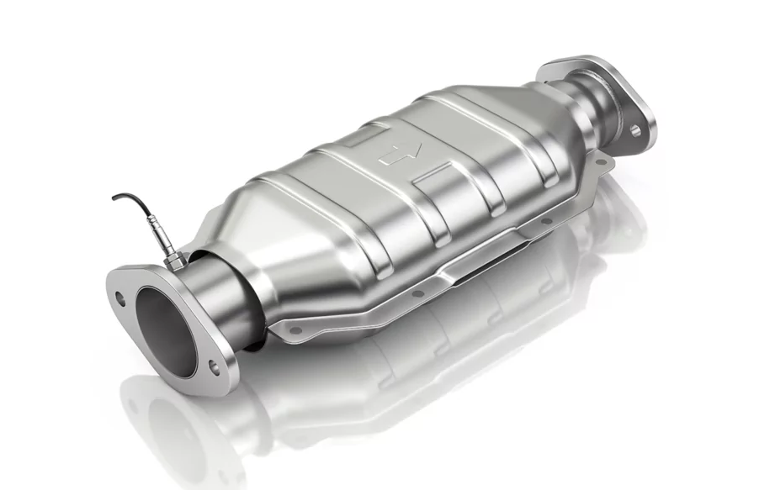
Catalytic Converter
Catalytic Converter
Overview
Definition: A device that reduces harmful emissions from the vehicle's exhaust.
Importance: Crucial for reducing environmental pollution.
Redox Reactions: Converts toxic gases into less harmful ones.
Application:
Used in gasoline
diesel engines,
other fuel-burning devices.
Notes:
Definition: The catalytic converter is a component of the exhaust system that uses chemical reactions to reduce the toxicity of emissions from an internal combustion engine.
Importance: It plays a vital role in meeting environmental regulations by converting harmful pollutants into water vapor, carbon dioxide, and nitrogen, which are less damaging to the atmosphere.
Redox Reactions: Through reduction and oxidation processes, the catalytic converter transforms harmful substances like carbon monoxide, nitrogen oxides, and hydrocarbons into less harmful gases.
Application: While primarily used in vehicles, catalytic converters are also applicable to other engines and heating devices that emit exhaust, helping to reduce their environmental impact.
Ensuring the proper function of the catalytic converter is essential for the vehicle's compliance with emission standards and overall environmental responsibility. Regular checks are necessary to maintain its effectiveness.

Slide 40

Muffler
Muffler
Overview
Definition: A component that reduces the noise emitted from a vehicle's exhaust system.
Importance: Controls sound pollution and enhances driving comfort.
Noise Reduction: Attenuates the sound of the engine's exhaust.
Construction: Made from steel and coated with aluminum.
Notes:
Definition: The muffler, often located at the rear of the car, is essential for dampening the noise produced during fuel combustion in the engine.
Importance: By mitigating engine noise, the muffler contributes to a more pleasant driving experience and helps comply with legal noise regulations.
Noise Reduction: It achieves noise reduction through a series of passages and chambers that disrupt and cancel out sound waves without impeding exhaust flow.
Construction: The use of steel and aluminum in its construction helps protect the muffler from the harsh chemicals present in exhaust gases, thereby extending its lifespan.
Maintaining the muffler is crucial as it impacts not just noise levels but also the overall health of the car's exhaust system. Damage or wear can result in increased noise and potential exhaust system inefficiencies.

Slide 41
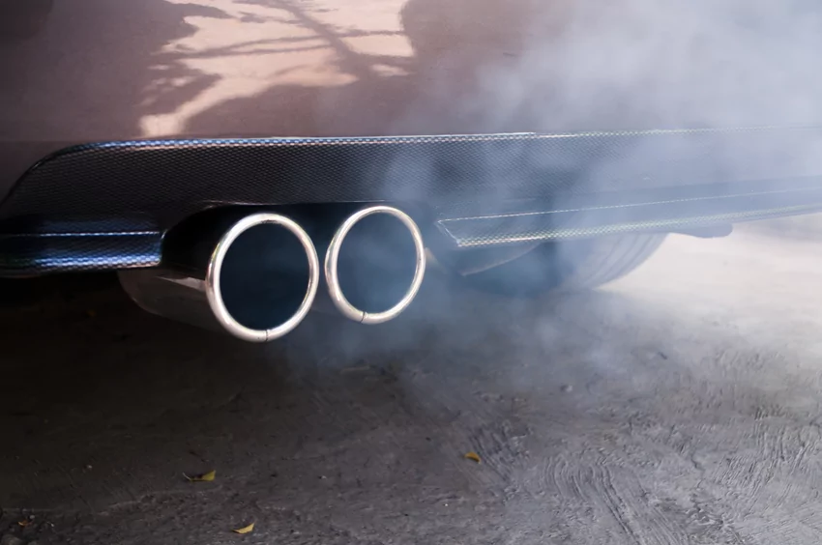
Tailpipe
Overview
Tail Pipe
Definition: A vehicle's exhaust outlet for expelling emissions.
Importance: Directs exhaust gases away from the vehicle to improve safety and health.
Exhaust Direction: Channels fumes from the muffler/catalytic converter to the air.
Construction: Designed for durability against corrosion and heat.
Notes:
Definition: The tailpipe is the final section of the car's exhaust system, functioning like a chimney to safely dispose of exhaust gases.
Importance: It's essential for ensuring that exhaust fumes are released in a manner that minimizes exposure to passengers and the environment.
Exhaust Direction: By extending to the rear of the car, the tailpipe ensures that exhaust is released behind the vehicle, reducing the chance of fumes entering the cabin or affecting surrounding people.
Construction: Tailpipes must withstand high temperatures and corrosive gases, so they're typically made of materials like stainless steel and are often supported by brackets to maintain their position.
Vulnerability: The tailpipe can be susceptible to damage from rear collisions or can deteriorate over time due to rust, potentially leading to leaks or improper emission dispersion.

Slide 42
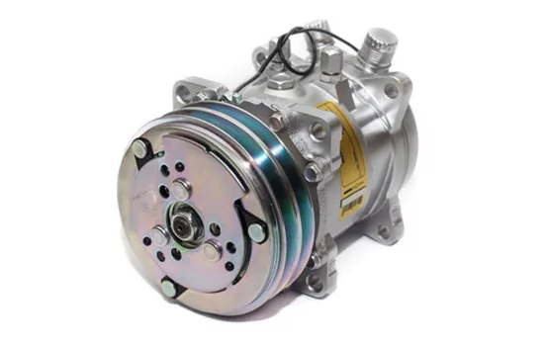
AC Compressor
Overview
AC Compressor
Definition: A device in a car's AC system that compresses and circulates refrigerant.
Importance: Vital for the air conditioning system to deliver cooled air to the interior.
Refrigerant Circulation: Compresses refrigerant from gas to liquid.
Climate Control: Enables temperature regulation inside the vehicle.
Notes:
Definition: The AC compressor is the heart of the air conditioning system, pressurizing the refrigerant to absorb heat and cool the cabin air.
Importance: It’s key to the functionality of the air conditioning, impacting comfort, especially in warm climates.
Refrigerant Circulation: As it compresses the refrigerant, the compressor changes it from a low-pressure gas to a high-pressure liquid, facilitating heat exchange.
Climate Control: The ability to cool the vehicle's interior is crucial for driver comfort and can also affect driver alertness on long trips.
Dependency: The efficiency of the AC compressor relies on adequate refrigerant levels and the integrity of the entire AC system, including the absence of leaks and a functioning engine cooling fan.

Slide 43
08 – Body & Visibility

Slide 44

Windshield
Overview
Windshield
Definition: The front window of a vehicle, providing visibility and protection.
Importance: Essential for driver visibility, safety, and comfort.
Visibility and Protection: Allows clear vision while shielding occupants.
Laminated Safety Glass: Constructed for durability and impact resistance.
Aerodynamics and UV Protection: Enhances vehicle efficiency and occupant comfort.
Notes:
Definition: The windshield, or windscreen, is a critical component of a vehicle's safety system, offering a clear view of the road ahead while protecting passengers from external elements.
Importance: Beyond visibility, the windshield contributes to the vehicle's structural integrity and aids in the deployment of airbags, making it a key element in occupant safety during collisions.
Visibility and Protection: It serves as a barrier against weather, debris, and insects, ensuring driver and passenger comfort and safety.
Laminated Safety Glass: This type of glass consists of two layers of glass with a plastic layer in between, making it strong and shatter-resistant to protect occupants during accidents.
Aerodynamics and UV Protection: The windshield's design also plays a role in reducing air drag, improving fuel efficiency, and can be treated to block harmful UV rays, protecting the interior and occupants from sun damage.

Slide 45

Windshield Wipers
Overview
Windscreen Wipers
Definition: Devices designed to clear the windshield for improved visibility.
Importance: Essential for maintaining clear vision in various weather conditions.
Visibility Maintenance: Removes rain, snow, and debris from the windshield.
Composition: Consists of metal arms and a rubber blade.
Operation: Powered by an electric motor, controlled by the driver.

Slide 46

Headlights
Overview
Headlights
Definition: Front-facing lights that illuminate the road for drivers.
Importance: Crucial for visibility during nighttime and adverse weather conditions.
Road Illumination: Enhances driver's vision at night or in low light.
Safety Feature: Aids in making the vehicle visible to other road users.
Direction Indicators

Slide 47

Taillights
Overview
Tail Lights
Definition: Rear lights that signal a vehicle's presence and actions.
Importance: Essential for communication and safety on the road.
Visibility Enhancement
Reverse Indication
Direction Indicators
Notes:
Definition: Tail lights are key components of a vehicle's lighting system located at the rear, serving to inform other road users of the vehicle's presence and movements, especially in low visibility situations.
Importance: Their role is critical in preventing accidents by enhancing visibility and communicating the driver's intentions, such as turning or reversing, thus facilitating safer road sharing.
Visibility Enhancement: Red tail lights help other drivers gauge the location and movement of a vehicle during the night or adverse weather conditions, improving overall road safety.
Reverse Indication: The inclusion of white lights specifically for reversing alerts other road users to the vehicle's backward movement, allowing for increased caution and response time.
Direction Indicators: Also known as turn signals, blinkers, or indicators, these lights are crucial for signaling a change in direction, informing others on the road of the driver's next move to avoid collisions and confusion.

Slide 48
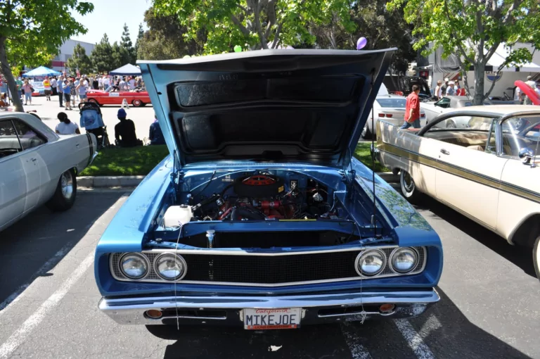
Car Hood
Overview
Car Hood
Definition: Called hood or bonnet, it’s the hinged cover over the engine compartment in vehicles.
Importance: Provides access for engine maintenance and repair.
Engine Access
Secure Latching
Notes:
Definition: The car hood, also known as the bonnet in some regions, serves as a protective and accessible cover for the engine of a vehicle, primarily in front-engine configurations.
Importance: It plays a crucial role not only in providing security for the engine compartment but also in allowing easy access for inspections, maintenance, and repairs, thereby ensuring the vehicle's longevity and performance.
Engine Access: The design of the hood is such that it can be easily opened to expose the entire engine bay, facilitating various service operations without obstruction.
Secure Latching: Safety is paramount, and the hood includes latching mechanisms to ensure it remains securely closed while the vehicle is in motion. For enhanced security or performance aesthetics.
Material and Design: While steel is common due to its durability, aluminum is sometimes used to reduce weight, enhancing fuel efficiency and performance. Design elements like hood scoops can provide additional engine cooling, whereas bulges and ornaments may serve aesthetic or branding purposes.

Slide 49

Trunk
Overview
Trunk
Definition: A compartment at the vehicle's rear for cargo storage.
Importance: Provides secure and convenient space for luggage and other items.
Storage Solution
Terminology
Notes:
The trunk, positioned at the back of most vehicles, is essential for safely storing and transporting luggage, groceries, and other items, keeping them out of the cabin for more passenger comfort and safety.

Slide 50
09– Advanced Vehicle Systems

Slide 51
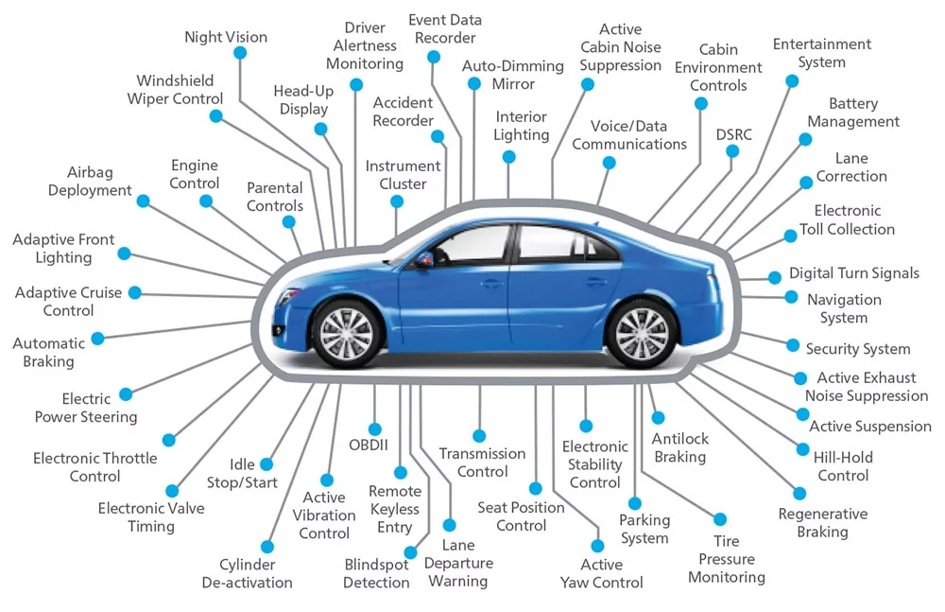
Notes:
Introduction to Advanced Vehicle Systems: We've primarily focused on mechanical components and systems crucial for vehicle operation. Beyond these, modern vehicles incorporate diagnostics and automated control systems that significantly enhance functionality, safety, and user experience.
Key Automated Systems and Diagnostics:
Tire Pressure Monitoring: Ensures optimal tire pressure for safety and efficiency.
Automated Braking: Applies brakes automatically to prevent collisions, enhancing safety.
Cruise Control: Maintains set highway speed, reducing driver fatigue and optimizing fuel consumption.
Infotainment Systems: Provides entertainment and information, integrating with personal devices for an enriched driving experience.
Security Systems: Protects against unauthorized access or theft, using advanced technology for peace of mind.
Automatic Wipers: Adjusts wiper speed based on rainfall intensity for clear visibility without driver intervention.
The Role of Automotive Engineering: These systems require sophisticated interaction with the vehicle's operational data. Automotive engineers develop and integrate these systems, ensuring accurate data interpretation and functionality.
System Integration and Future Capabilities: It's common for multiple systems to monitor a single data point, enhancing reliability and performance. Such integration lays the groundwork for future advancements, allowing new features and capabilities to be introduced seamlessly.
Expanding Capabilities into the Future: The blend of mechanical engineering and information technology marks a dynamic future for automotive engineering. As vehicles become more connected and autonomous, engineers' roles evolve to encompass a broader range of skills and knowledge, driving the future of transportation technology.

Slide 52
Thank You!
Notes:
As we conclude our exploration of

